Slide 1
Lab 14 & 15

Slide 2
Lab Goal
Today we are going to work with java classes, however we have been using java classes for most of the semester already.
I am referring to the TextFileInput class we have been working with to read from text files
Today we are going to create a java class money and create some instance variables and methods for it

Slide 3
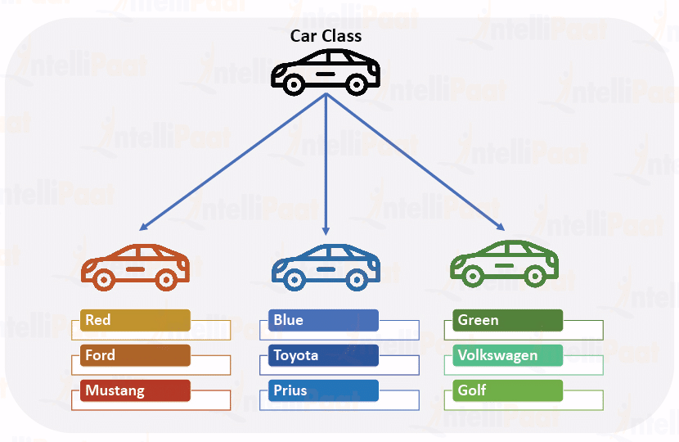
Classes, Objects of classes and instance variables

Slide 4

Money Class
We want to get started by making a Lab 14 project in eclipse
Inside the Lab 14 project we want to make a Money.java class
Inside the class you want to create two integer instance variable dollars and cents, instance variables are declared using the private keyword

Slide 5
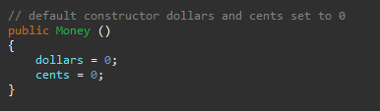
Money Class constructors
We also want to define constructors for the Money class, the constructors are used to create objects of a class, we can also specify whether or not we want arguments for a constructor.
Lets start by creating a default constructor, this constructor will not take arguments and will initialize the instance variables dollars and cents to 0 for the newly created object
Note that the constructor needs to be inside the curly braces for the Money class

Slide 6

Money class constructors
We also want to create a constructor that allows us to pass two integer parameters as an argument, the ability to do this is known as overloading
How we do this is making another constructor except this time we put the two arguments inside the parenthesis, when the constructor is called the program will choose the constructor based on the arguments you pass.

Slide 7

Get methods
Because dollars and cents are instance variables declared with the private specifier you need to create get methods to retrieve their value outside of the class
Get methods are simple methods that don’t take any arguments and return the value specified

Slide 8

Create a toString() method
Now we want to create a toString method this method does not take any arguments and should have a String return type, the toString method allows use to pass objects of a class in our print statement and java will know to print the value returned by the toString method
You will have to be creative using either substring or if else statements to handle properly adding a leading 0 on the cents if needed, and then combine the string values of the dollars and cents formatted properly and returned.

Slide 9
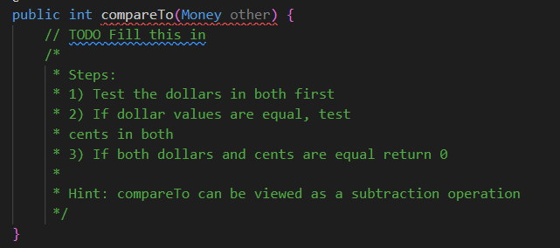
Create an integer compareTo method
You want to compare the dollar, cents values between the object that the method is called on and the one that is passed as an argument
Based on which one has more money return values. If equal return 0, if less -1 and if more 1

Slide 10
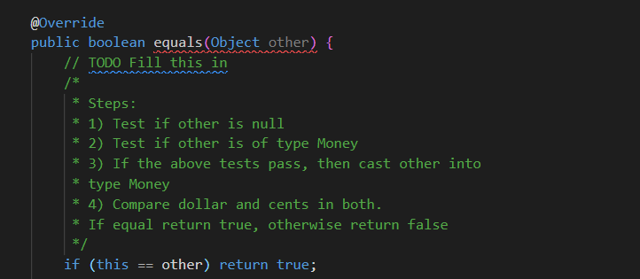
Boolean equals method
You want to create an equals method as described below
To check if the object is of type Money you want to use the instanceof operator

Slide 11

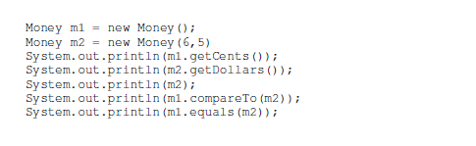
Create a test for your class
You can test your class either by including a main method in your Money class or by creating a new class and putting a main method there

Slide 12
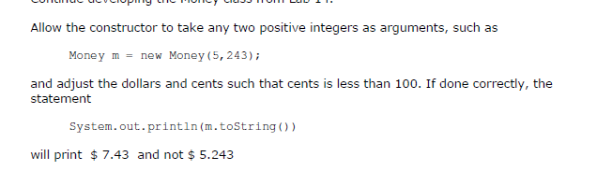
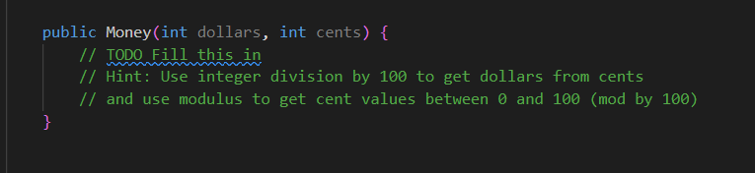
Adjust two parameter constructor
We want to adjust the two parameter constructor, to make the adjustments as described below you may find it helpful to use the mod function to get separate the cents from the third digit, also keep in mind that with integers you don’t have decimal values so given
int m = 12; m/10 = 1

Slide 13
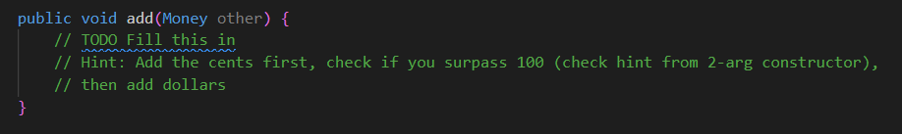
You want to create an add method
As stated before it is helpful to add the cents from your argument to the object the argument was called on’s cents and then if need use mod and integer division to separate the dollars from the cents
You are adding the arguments amount to the calling object you are not changing anything in the object passed as an argument

Slide 14
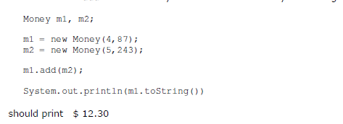
Test your code

